Slide 1
Module -5
Introduction, Challenges, Types of social Network Graphs
Mining Social Media: Influence and Homophily, Behaviour Analytics, Recommendation
in Social Media: Challenges, Classical recommendation Algorithms, Recommendation
using Social Context, Evaluating recommendations.

Slide 2
Social Media Mining
Social media mining involves extracting and analyzing patterns, trends, and insights from the vast amount of data generated on social media platforms. With billions of users worldwide, social media platforms like Facebook, Twitter, Instagram, and LinkedIn offer a rich source of information about human behavior, interactions, and preferences. Social media mining encompasses various tasks such as sentiment analysis, trend detection, user profiling, recommendation systems, and more.

Slide 3
Challenges in Social Media Mining
Volume: Social media platforms generate enormous amounts of data daily, requiring efficient storage, processing, and analysis techniques.
Variety: Social media data comes in various formats, including text, images, videos, and user interactions, posing challenges for integration and analysis.
Velocity: Data on social media is generated in real-time, necessitating real-time processing and analytics capabilities to keep up with the pace of data generation.
Veracity: Social media data can be noisy, unreliable, and biased, requiring preprocessing and cleaning to ensure data quality.
Privacy and Ethical Concerns: Mining social media data raises privacy concerns regarding the collection and use of personal information. Ensuring ethical data practices and respecting user privacy is essential.

Slide 4
Types of Social Network Graphs
Undirected Graphs: In undirected graphs, nodes represent users, and edges represent connections such as friendships or interactions without a specified direction.
Directed Graphs: Directed graphs model asymmetric relationships between users, such as followers on Twitter or connections on LinkedIn.
Weighted Graphs: Weighted graphs assign weights to edges to represent the strength or intensity of relationships between users.
Signed Graphs: Signed graphs incorporate positive or negative signs on edges to represent positive or negative relationships, such as trust or sentiment.
Multi-layered Graphs: Multi-layered graphs capture different types of relationships or interactions between users across multiple layers, allowing for more comprehensive analysis.

Slide 5
Mining Social Media: Influence and Homophily
Influence: Identifying influential users or content on social media is essential for viral marketing, opinion mining, and trend prediction.
Homophily: Homophily refers to the tendency of users to interact with others who share similar characteristics or interests. Understanding homophily helps in targeted advertising, community detection, and recommendation systems.

Slide 6
Behavior Analytics in Social Media
Behavior analytics in social media involves the study of user actions, interactions, and engagement patterns to gain insights into user behavior. This analysis helps in understanding how users navigate social media platforms, interact with content, and engage with other users. Behavior analytics encompasses various aspects, including:
Content Consumption Patterns: Analyzing what types of content users consume, how frequently they engage with it, and which topics or hashtags they are interested in. This information helps in content curation, personalized recommendations, and identifying trending topics.
User Engagement Metrics: Monitoring metrics such as likes, shares, comments, retweets, and reactions to assess user engagement with content. Understanding user engagement patterns helps in evaluating content effectiveness, identifying influential users, and measuring campaign success.

Slide 7
Cont.
User Interaction Networks: Analyzing the structure of social networks, including follower-followee relationships, retweet networks, and mentions, to identify communities, influencers, and information diffusion pathways. This information is valuable for targeted advertising, influencer marketing, and viral content prediction.
Temporal Analysis: Studying how user behavior evolves over time, including daily, weekly, or seasonal patterns in posting, engagement, and activity levels. Temporal analysis helps in timing content publication, scheduling campaigns, and predicting peak engagement periods.
Sentiment Analysis: Analyzing the sentiment expressed in user-generated content, such as tweets, comments, and reviews, to understand public opinion, brand perception, and customer satisfaction. Sentiment analysis enables reputation management, crisis detection, and brand sentiment tracking.

Slide 8
Recommendation in Social Media
Recommendation systems in social media aim to personalize the user experience by suggesting relevant content, connections, or products based on user preferences, behaviors, and social context. These systems leverage various techniques, including:
Content-Based Filtering
Collaborative Filtering
Social Context-Aware Recommendation

Slide 9
Content-based filtering
Content-based filtering is a recommendation technique used in information retrieval and recommendation systems to suggest items to users based on the properties or characteristics of those items. It relies on analyzing the features or attributes of items that users have interacted with in the past to recommend similar items that match their preferences. Content-based filtering is commonly employed in various domains, including e-commerce, news websites, music streaming platforms, and movie recommendation systems.

Slide 10
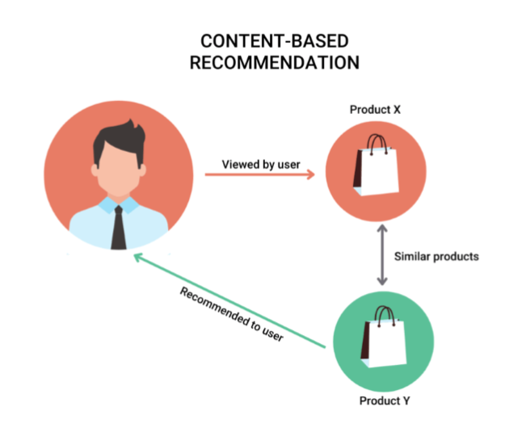

Slide 11
Item Representation: Each item in the system is represented by a set of features or attributes that describe its properties. These features could include textual content, metadata, tags, genres, or any other relevant information.
User Profile: The system maintains a user profile that captures the user's preferences based on their past interactions with items. This profile is typically built by analyzing the items the user has liked, rated, or interacted with, and extracting features from those items.
Similarity Calculation: Content-based filtering calculates the similarity between items in the system based on their feature representations. Various similarity metrics, such as cosine similarity or Jaccard similarity, can be used to measure the similarity between items.
Recommendation Generation: Given a user profile, the system identifies items that are similar to the ones the user has interacted with in the past. These similar items are then recommended to the user based on their predicted relevance and similarity to the user's preferences.

Slide 12
advantages
Personalization: Content-based filtering provides personalized recommendations to users based on their unique preferences and interests.
Transparency: The recommendation process is transparent since recommendations are based on explicit features or attributes of items, making it easier for users to understand why certain items are recommended to them.
No Cold Start Problem: Content-based filtering can mitigate the cold start problem, as recommendations can be made based on item features alone, without requiring historical user data.
Serendipity: Content-based filtering can introduce users to new and diverse items that share similar features with items they have interacted with in the past, leading to serendipitous discoveries.

Slide 13
Collaborative filtering
Collaborative filtering is a widely used recommendation technique that leverages the collective behavior of users to generate personalized recommendations. Unlike content-based filtering, which relies on item features, collaborative filtering focuses on analyzing user-item interactions and similarities between users to make recommendations. It is based on the assumption that users who have similar preferences or behaviors in the past are likely to have similar preferences in the future.

Slide 14
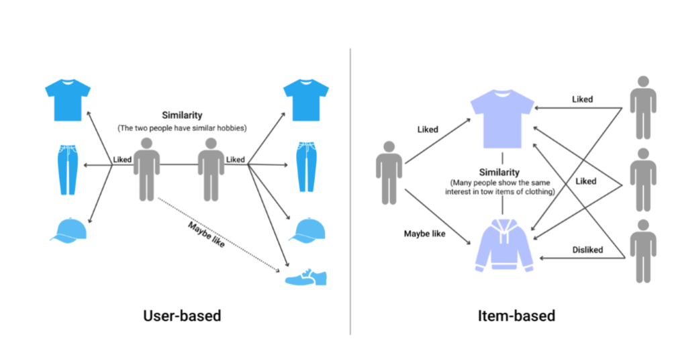

Slide 15
User-Item Interaction Data: Collaborative filtering relies on a dataset that captures the interactions between users and items. These interactions could include ratings, likes, purchases, views, or any other form of user engagement with items in the system.
User Similarity Calculation: Collaborative filtering calculates the similarity between users based on their past interactions with items. Various similarity metrics, such as cosine similarity or Pearson correlation, can be used to measure the similarity between user profiles.
Neighborhood Selection: Collaborative filtering selects a subset of similar users, known as the "neighborhood," for each target user. The neighborhood typically consists of the most similar users based on their interaction patterns with items.
Rating Prediction: Given the user's neighborhood, collaborative filtering predicts the ratings or preferences of the target user for items they have not yet interacted with. This prediction is based on aggregating the ratings or preferences of similar users for those items.
Recommendation Generation: Based on the predicted ratings or preferences, collaborative filtering generates a list of top-ranked items to recommend to the target user. These recommended items are typically those with the highest predicted ratings or preferences.

Slide 16
Types of Collaborative Filtering
Memory-Based Collaborative Filtering: Memory-based collaborative filtering directly uses user-item interaction data to compute user similarities and make recommendations. It can be divided into two subtypes:
User-Based Collaborative Filtering: Computes similarities between users and recommends items liked by similar users.
Item-Based Collaborative Filtering: Computes similarities between items and recommends items similar to those already liked by the user.
Model-Based Collaborative Filtering: Model-based collaborative filtering uses machine learning algorithms to learn latent factors or features from the user-item interaction data. These learned models are then used to make predictions and generate recommendations. Common techniques include matrix factorization, singular value decomposition (SVD), and factorization machines.

Slide 17
Advantages of Collaborative Filtering
No Dependency on Item Features: Collaborative filtering does not rely on item features or metadata, making it suitable for recommending items in domains where item features are sparse or unavailable.
Serendipity: Collaborative filtering can recommend items that are not explicitly similar to items the user has interacted with, leading to serendipitous discoveries and exposure to new content.
Scalability: Collaborative filtering can scale to large datasets and user populations since it only requires user-item interaction data and similarity calculations between users.

Slide 18
3. Social Context-Aware Recommendation
Social context-aware recommendation leverages information about social connections, interactions, and influence within a social network to make personalized recommendations. By considering the social context, such as friendships, followership, and shared interests, these systems can identify items that are not only relevant to the user's preferences but also aligned with their social network dynamics. Social context-aware recommendation systems typically involve the following components.

Slide 19
Cont..
Social Graph Representation: The social graph represents the network of social connections between users, where nodes represent users, and edges represent relationships such as friendships, followership, or interactions.
User Influence Analysis: Social context-aware recommendation systems analyze the influence and authority of users within the social network. Influential users may have a greater impact on their followers' preferences and behaviors, making their recommendations more influential.
Community Detection: Identifying communities or groups of users with shared interests or behaviors within the social network. Community detection helps in understanding the social context and identifying relevant items for recommendation within specific user clusters.
Social Influence Propagation: Modeling the propagation of influence and information within the social network. Social influence propagation algorithms predict the spread of preferences, recommendations, or trends from influential users to their followers, guiding the recommendation process.
Social Filtering: Combining social context information with user preferences and item features to filter and prioritize recommendations. Social filtering techniques adjust recommendation scores based on social influence, user similarity, or community dynamics to enhance recommendation relevance.

Slide 20
Recommendation using Social Context:
Social Influence Analysis: Social influence analysis identifies influential users or communities within a social network and incorporates their preferences or recommendations into the recommendation process. This helps in identifying popular or trending items and improving recommendation relevance.
Friendship-based Recommendations: Friendship-based recommendations leverage social connections between users to recommend items that are popular among friends or similar users. This approach enhances recommendation relevance by considering social influence and user similarity.
Community Detection: Community detection techniques identify communities or groups of users with shared interests or behaviors within a social network. Recommendations can be tailored to each community's preferences, improving recommendation diversity and relevance.
Collaborative Filtering with Social Graph: Collaborative filtering algorithms can be enhanced by incorporating the social graph structure and user interactions into the recommendation process. This includes techniques such as social regularization or matrix factorization with social regularization.

Slide 21
Evaluating Recommendations:
Accuracy Metrics: Accuracy metrics such as precision, recall, and F1-score measure the effectiveness of recommendations in predicting user preferences or interactions accurately.
Diversity Metrics: Diversity metrics evaluate the variety and novelty of recommended items, ensuring that recommendations cover a wide range of user interests and preferences.
Serendipity Metrics: Serendipity metrics assess the ability of recommendation systems to introduce users to unexpected or novel items that they may not have discovered otherwise.
Coverage Metrics: Coverage metrics measure the proportion of items in the catalog that are recommended to users, ensuring that recommendations are comprehensive and inclusive.
User Satisfaction Surveys: User satisfaction surveys and feedback mechanisms collect user feedback on the relevance, usefulness, and overall quality of recommendations, providing valuable insights for improving recommendation systems.

Slide 22
Sample Question
Define Social Media analysis
Explain social media graph and their types.
Explain social media mining
Describe various type of recommendation algorithm
Elaborate behavior analysis in details.

